Slide 1
PYTHON
APPLICANTS
PROFILE
Loan Approval Data Analysis
APPROVAL
STATUS
Preprocessing and visualization to explore applicant profiles and loan approval patterns
FEATURES
INSIGHTS
EXPLORATORY DATA ANALYSIS
Tools: Python • Pandas • NumPy • Matplotlib • Seaborn
Prepared by: Priyanka Asalekar

Slide 2
Project Overview
A Python project focused on preprocessing and visualizing loan application data.
This project explores 4,269 loan application records with 13 fields, including applicant income, loan amount, credit score, assets, education, employment status and loan outcome.
The notebook inspects data quality and column types, summarizes numeric and categorical variables, creates distributions and comparisons, checks potential outliers in CIBIL scores using the IQR method, and explores relationships between financial features and loan status.
PROJECT FILE
DATASET
Loan approval python project.ipynb
loan_approval_dataset.csv
• 4,269 rows • 13 columns
LOAN APPROVAL ANALYSIS • 02

Slide 3
Project Objectives
Understand applicant characteristics and explore patterns associated with loan outcomes.
1
Inspect dataset structure, data types, distinct values, missing values and duplicate rows.
Summarize numeric and categorical features using descriptive statistics and value counts.
2
Visualize loan status and financial-feature distributions using histograms, count plots and box plots.
3
Explore income–loan amount relationships and feature correlations; investigate potential CIBIL-score outliers with IQR.
4
LOAN APPROVAL ANALYSIS • 03

Slide 4
Tools & Workflow
Libraries and analysis steps used in the submitted Jupyter Notebook.
TOOLS & TECHNOLOGY
WORKFLOW
• Python — analysis workflow and control logic
1
Load the CSV into a Pandas DataFrame
2
Inspect shape, types, missing values and duplicates
• Pandas — loading, inspecting and preparing tabular data
• NumPy — numerical operations
3
Review descriptive and categorical summaries
• Matplotlib and Seaborn — statistical charts
4
Create histograms, count plots, box plots and scatter plot
• Jupyter Notebook — documenting and running analysis
Apply IQR-based CIBIL outlier checks and correlation heatmap
5
LOAN APPROVAL ANALYSIS • 04

Slide 5
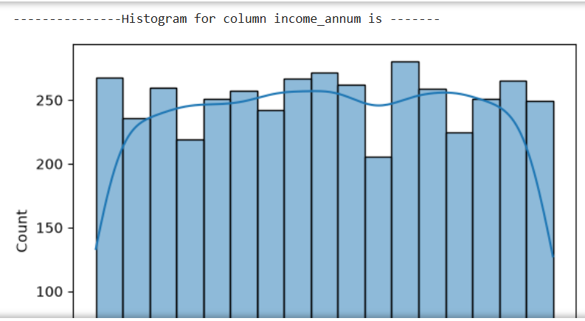
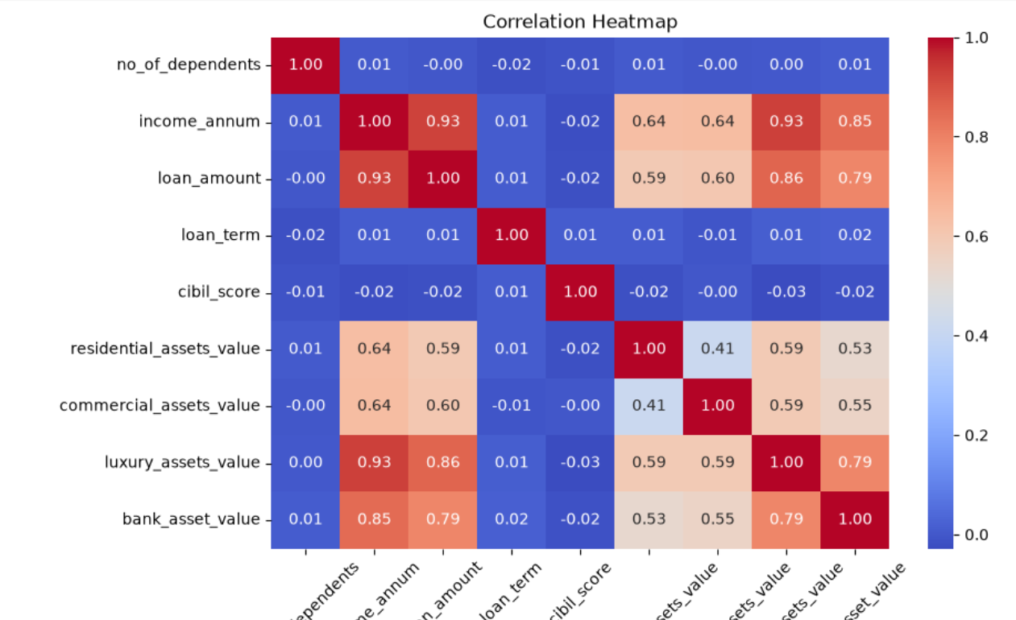
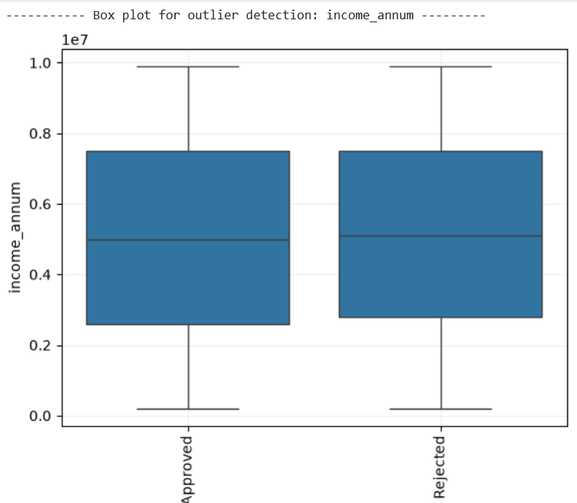
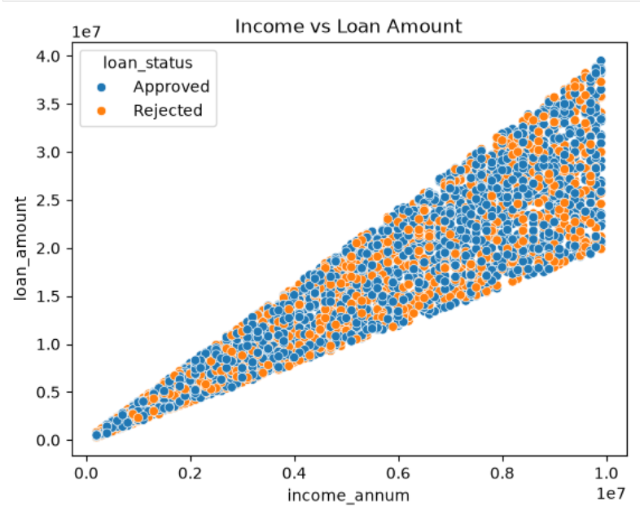
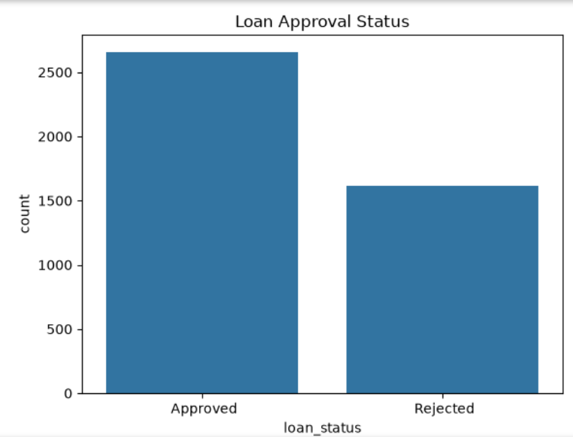
Project Visualizations
LOAN APPROVAL ANALYSIS • 05

Slide 6
Conclusion
Summary of the analysis and Python skills demonstrated.
This project demonstrates an exploratory data analysis workflow for loan application data, from data-quality checks and descriptive summaries to visual comparisons and correlation analysis.
KEY LEARNING AREAS
• Loading and inspecting CSV data with Pandas
• Summarizing numeric and categorical columns
• Visualizing patterns with Matplotlib and Seaborn
• Investigating potential CIBIL-score outliers with IQR
LOAN APPROVAL ANALYSIS • 06

